Slide 1

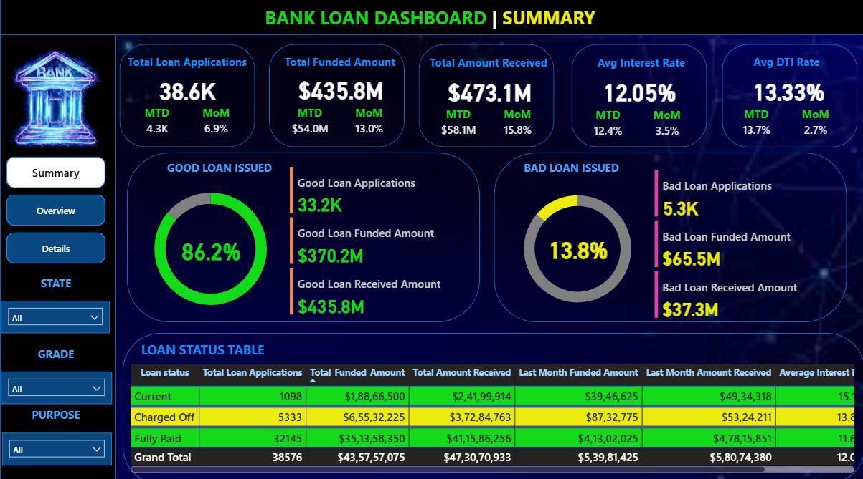


Bank Loan Performance
Dashboard
Created by
Pranav Mukeshkumar Patel
An end-to-end analysis using SQL and Power BI

Slide 2

Problem statement
Financial institutions require a clear and continuous understanding of their lending activities to monitor performance, mitigate financial risk, and make strategic decisions. However, raw loan data is often complex and voluminous, making it difficult for stakeholders to extract timely and meaningful insights.
This project addresses this challenge by developing an interactive Power BI dashboard that transforms complex financial data into actionable intelligence for tracking key metrics, analyzing trends, and assessing loan portfolio health.

Slide 3

Project Objectives
The primary goal was to develop a comprehensive solution for analyzing and visualizing the bank's loan portfolio. The specific objectives were:
Calculate and Monitor Key Performance Indicators (KPIs), including Month-to-Date (MTD) and Month-over-Month (MoM) performance metrics.
Analyze and Segment the Loan Portfolio into 'Good Loan' and 'Bad Loan' categories to identify key risk drivers and financial exposure.
Design and Build Three Dynamic Dashboards in Power BI (Summary, Overview, and Details) tailored for different levels of stakeholder analysis.
Extract Actionable Insights from the data to provide clear recommendations for improving lending strategies and mitigating risk.

Slide 4




Methodology
&
Tools
1. Data Prep & Validation (SQL)
2. Data Modeling (Power BI)
3. Calculation & Analysis (DAX)
Star Schema Model
Date Table for Time Intelligence
Power Query for Transformations
20+ DAX Measures for KPIs
Advanced Time Intelligence (MTD, MoM)
Good vs. Bad Loan Segmentation
• Data Staging in MYSQL
•Query-Based Cleaning
•InitialKPI Verification
4. Visualization & Reporting (Power BI)
3-Page Interactive Report
Dynamic Field Parameters
User-Focused Interactivity

Slide 5

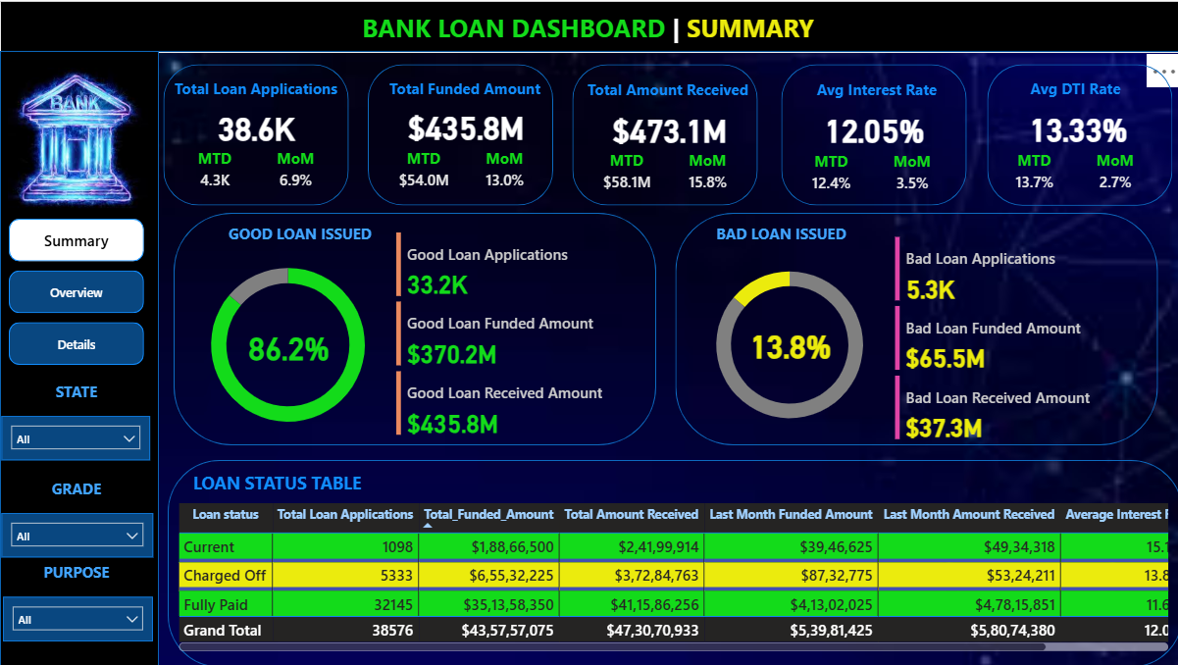
Dashboard Snapshot: Strong Overall Growth & Portfolio Health
The Summary dashboard provides an at-a-glance health check. We tracked 38.6K applications, resulting in over $435M in funded loans.
Crucially, all key metrics show strong positive Month-over-Month growth, with Amount Received growing by 15.8%, indicating healthy repayment trends.
The portfolio is largely healthy, with 'Good Loans' representing 86.2% of all applications. However, the remaining 13.8% of 'Bad Loans' represents a significant financial risk that we'll quantify next.

Slide 6
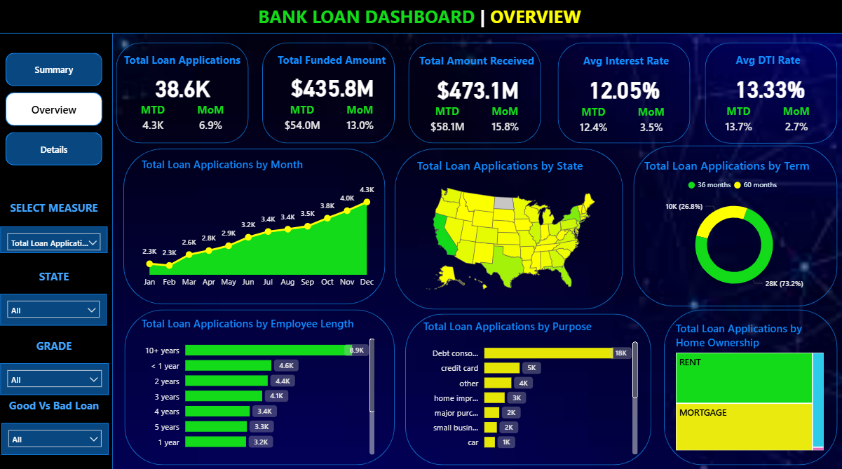
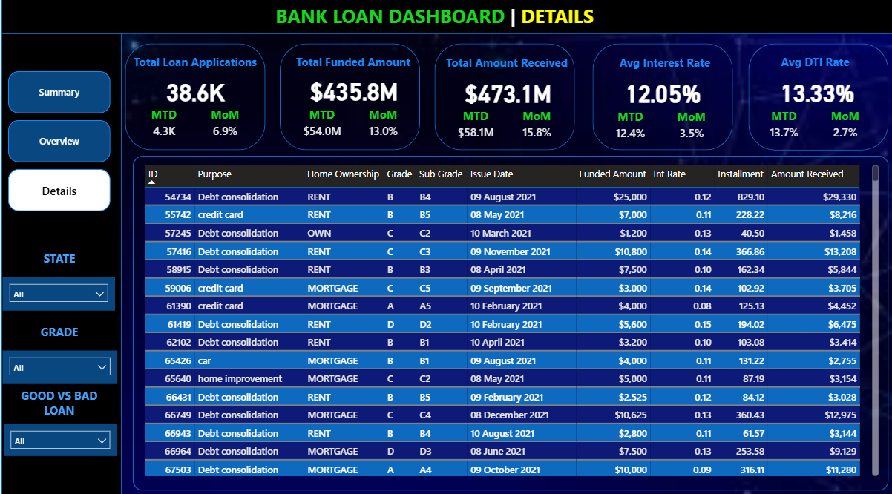
Deep Dive: Who Are Our Customers and Why Are They Borrowing?
The Overview dashboard allows us to segment the data and understand the drivers behind the KPIs.
Primary Motivation: The overwhelming majority of loans—over 18,000 applications—are for "Debt Consolidation." This tells us our main service is helping customers manage existing debt.
Key Borrower Segment: Borrowers with '10+ years' of employment history are our largest and most valuable segment, taking out the most loans by a significant margin.
Geographic Focus: The map clearly shows that California is by far our largest market, representing the highest volume of applications and funded amounts.

Slide 7
The Bottom Line: Quantifying the True Cost of Risk
This is the most critical financial insight from the project. The net loss from defaulted loans is over $28 million.
This finding is crucial because it shows that the losses from just 13.8% of the portfolio wiped out over 40% of the profits generated by the healthy 86%.
This quantifies the immense financial incentive for the bank to reduce its default rate.
Good Loans Profit: +$65.5 Million
Bad Loans Loss: -$28.2 Million
Actual Net Gain: $37.3 Million

Slide 8




Our Recommendations: A Data-Driven Path Forward
Refine Risk Assessment:
Action: Launch a targeted analysis on the 5,333 'Charged Off' loans. Identify common traits (e.g., DTI, grade, purpose) of defaulting borrowers to tighten the loan approval criteria for new applicants.
Focus Marketing Efforts:
Action: Double down on marketing campaigns that target customers looking for "Debt Consolidation," as this is our proven primary market.
Target High-Value Segments:
Action: Develop a targeted marketing campaign or a premium loan product for our most valuable segment: customers with '10+ years' of employment and existing mortgages.

Slide 9

Conclusion & Project Impact
This project successfully transformed a complex dataset into a clear, reliable, and interactive analytical tool.
It uncovered key financial insights, including a $28.2M net loss from defaulted loans, and identified the most valuable customer segments.
The dashboard and the data-driven recommendations provide a clear path for the bank to mitigate risk and improve profitability.

Slide 10
Thank You
Created by : Pranav Patel
Questions?
https://www.linkedin.com/in/pranav-patel-www22447630a/
https://github.com/pranav444444/Bank_Loan_Analysis_SQL_PowerBI_Project

